Slide 1
10th CBSE Crash Course
Information Brochure
Course Schedule- D03/T03. Owner- CDO, Valid till Feb 2022

Slide 2
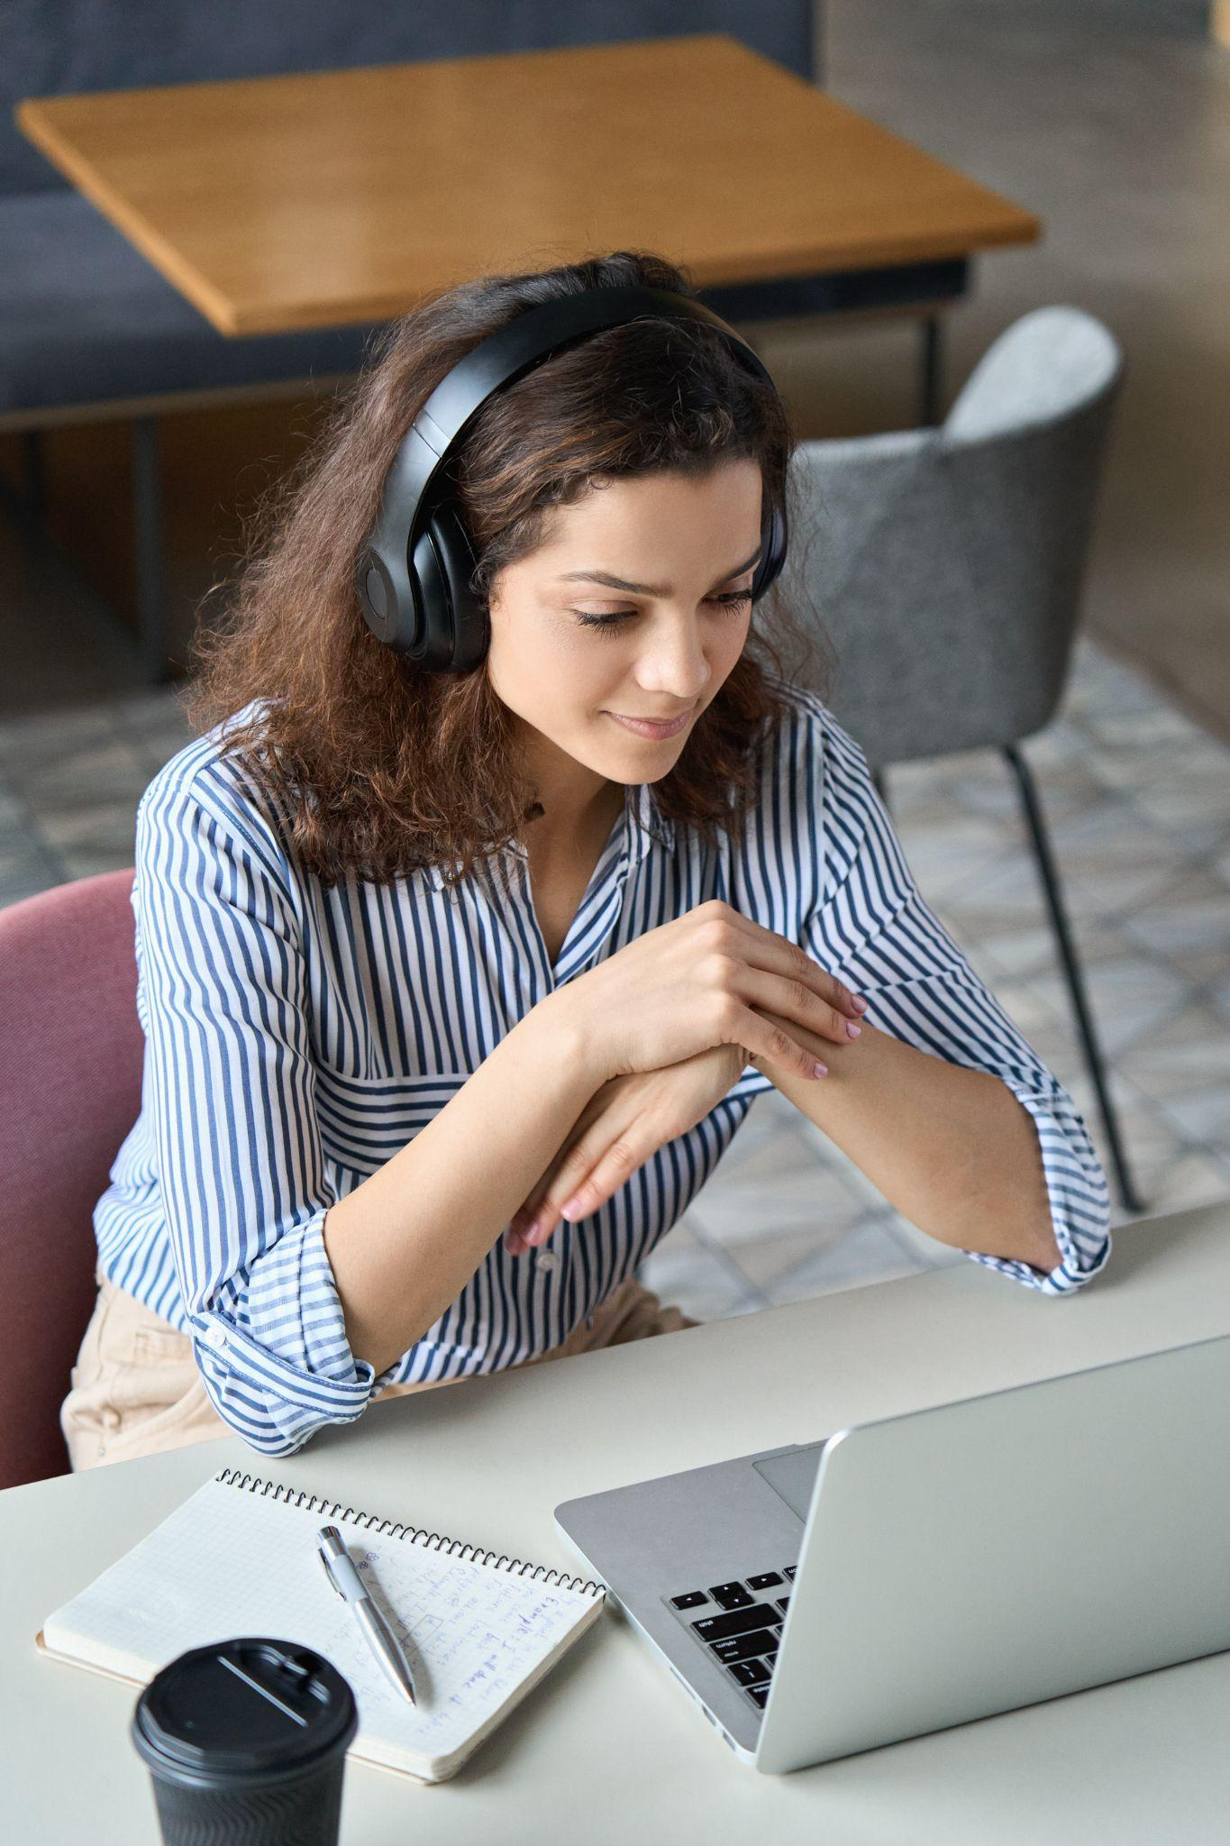
01
Overview
02
Course overview
03
Faculty
04
Schedule
05
Timings
10th CBSE Crash Course
Schedule
06
FAQ
07
Contact Information

Slide 3
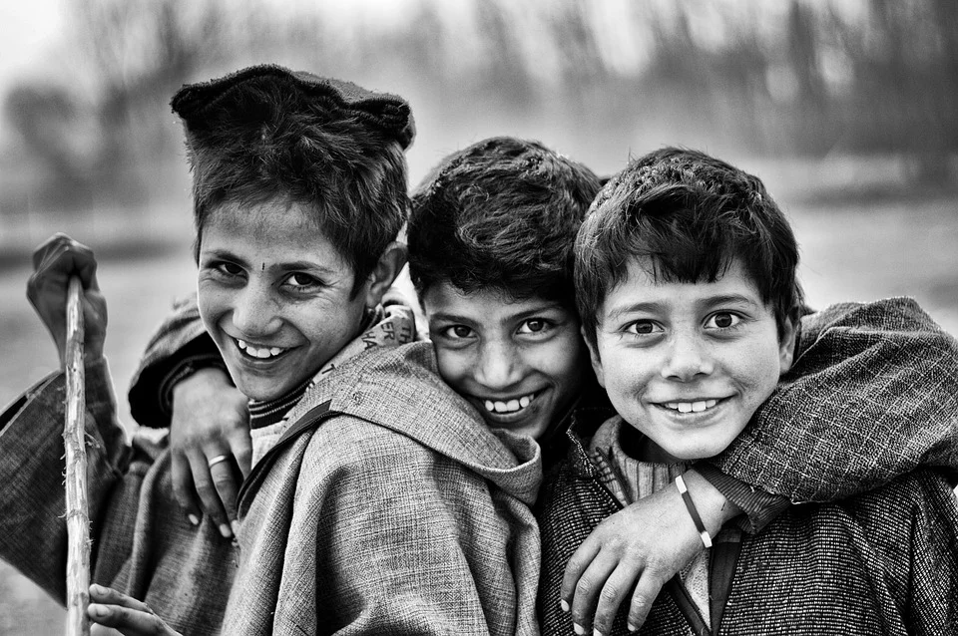
01
Overview
Welcome to the Tutoroot- CBSE Crash Course for the 10th Standard!! Hope you will enjoy the classes and learn while having fun!!

Slide 4
01 Course overview
Tutoroot is offering a crash course for 10th Standard CBSE class students!
Start Date
21st Dec 2021
End Date
13th Feb 2022
Total number of hours = 120
Subject ​ | Hours ​
Physics ​ | 16
Biology ​ | 16
Chemistry ​ | 16
Mathematic​ | 32
Recoup hours ​ | 40
Total ​ | 120
Subject ​ | No. of hours per week ​
Physics ​ | 2​
Chemistry ​ | 2​
Biology ​ | 2​
Mathematic​ | 4​
Total ​ | 10 ​
Subject ​ | Recoup hours per week ​
Physics ​ | 1​
Chemistry​ | 1​
Biology ​ | 1​
Mathematic​ | 2​
Total​ | 5​

Slide 5
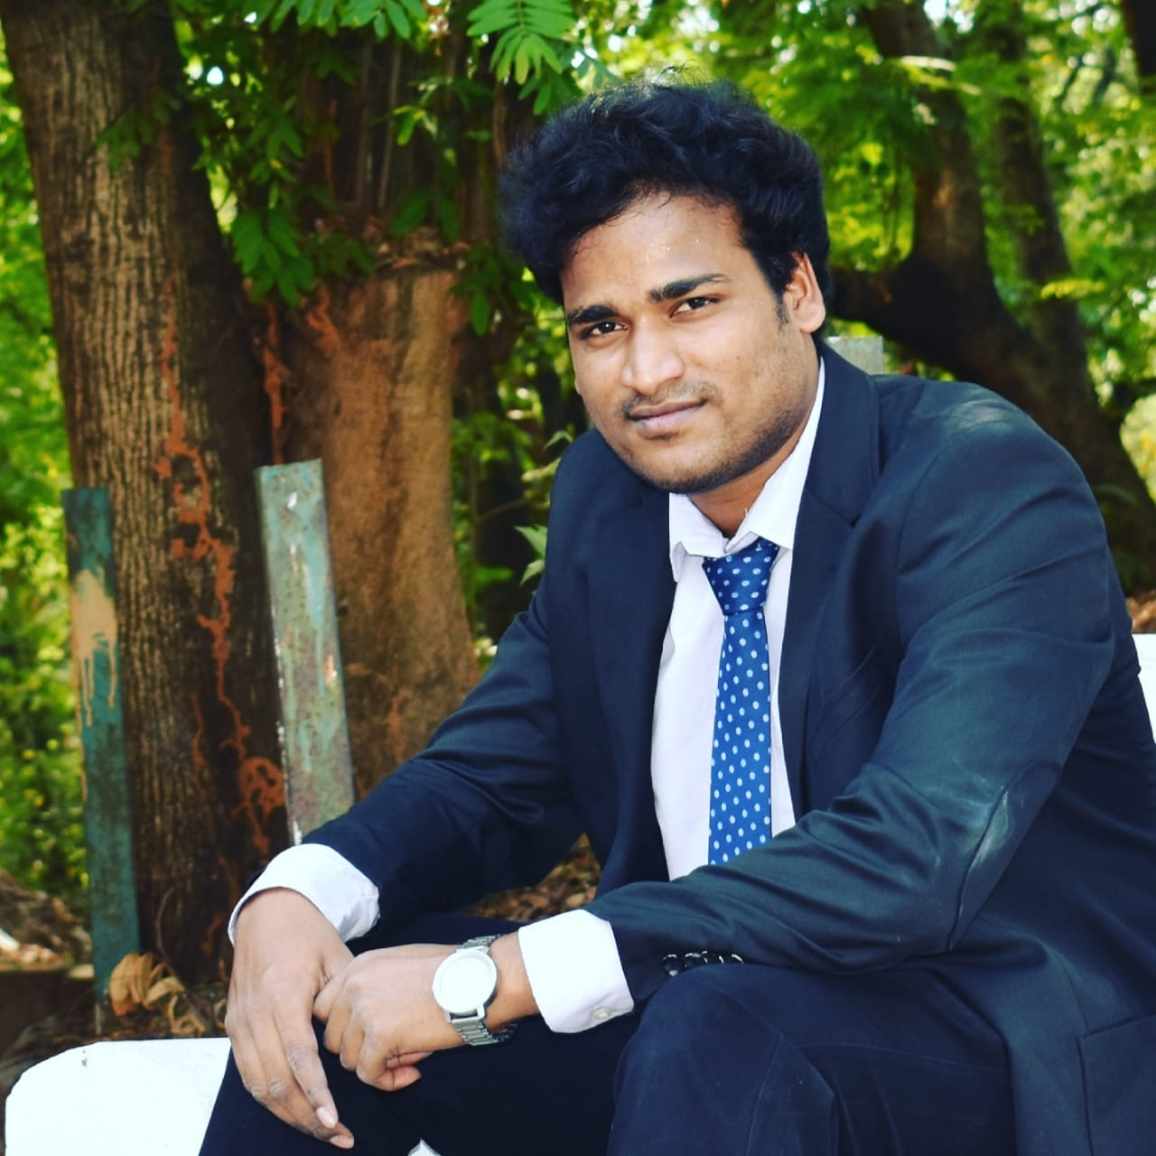
02
Faculty
I am vinay !! I am going to be your online class teacher!! I will also take the Chemistry classes for you!!
Let me introduce you to other teachers!!
All of them are as cool as me!!
Guaranteed!!

Slide 6
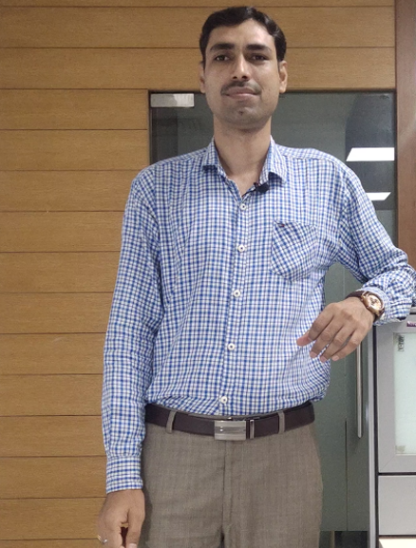
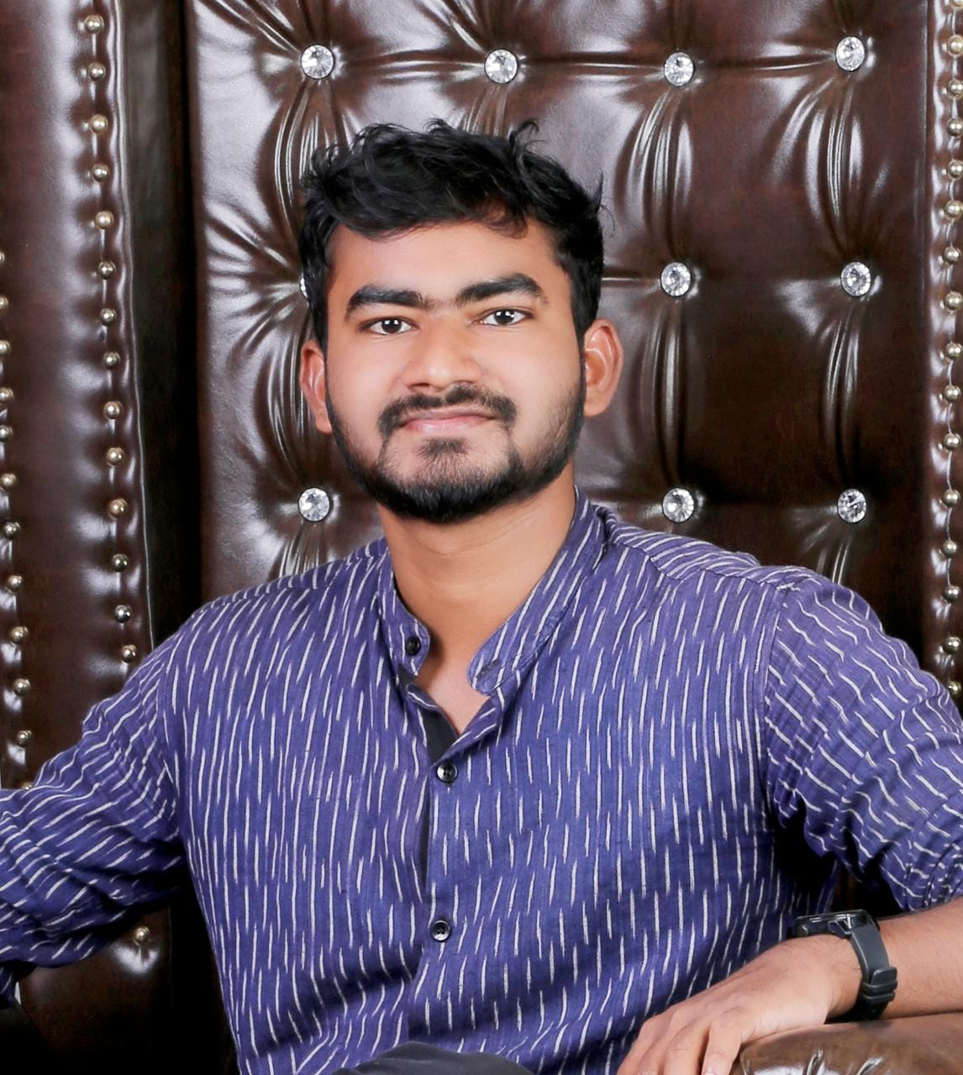
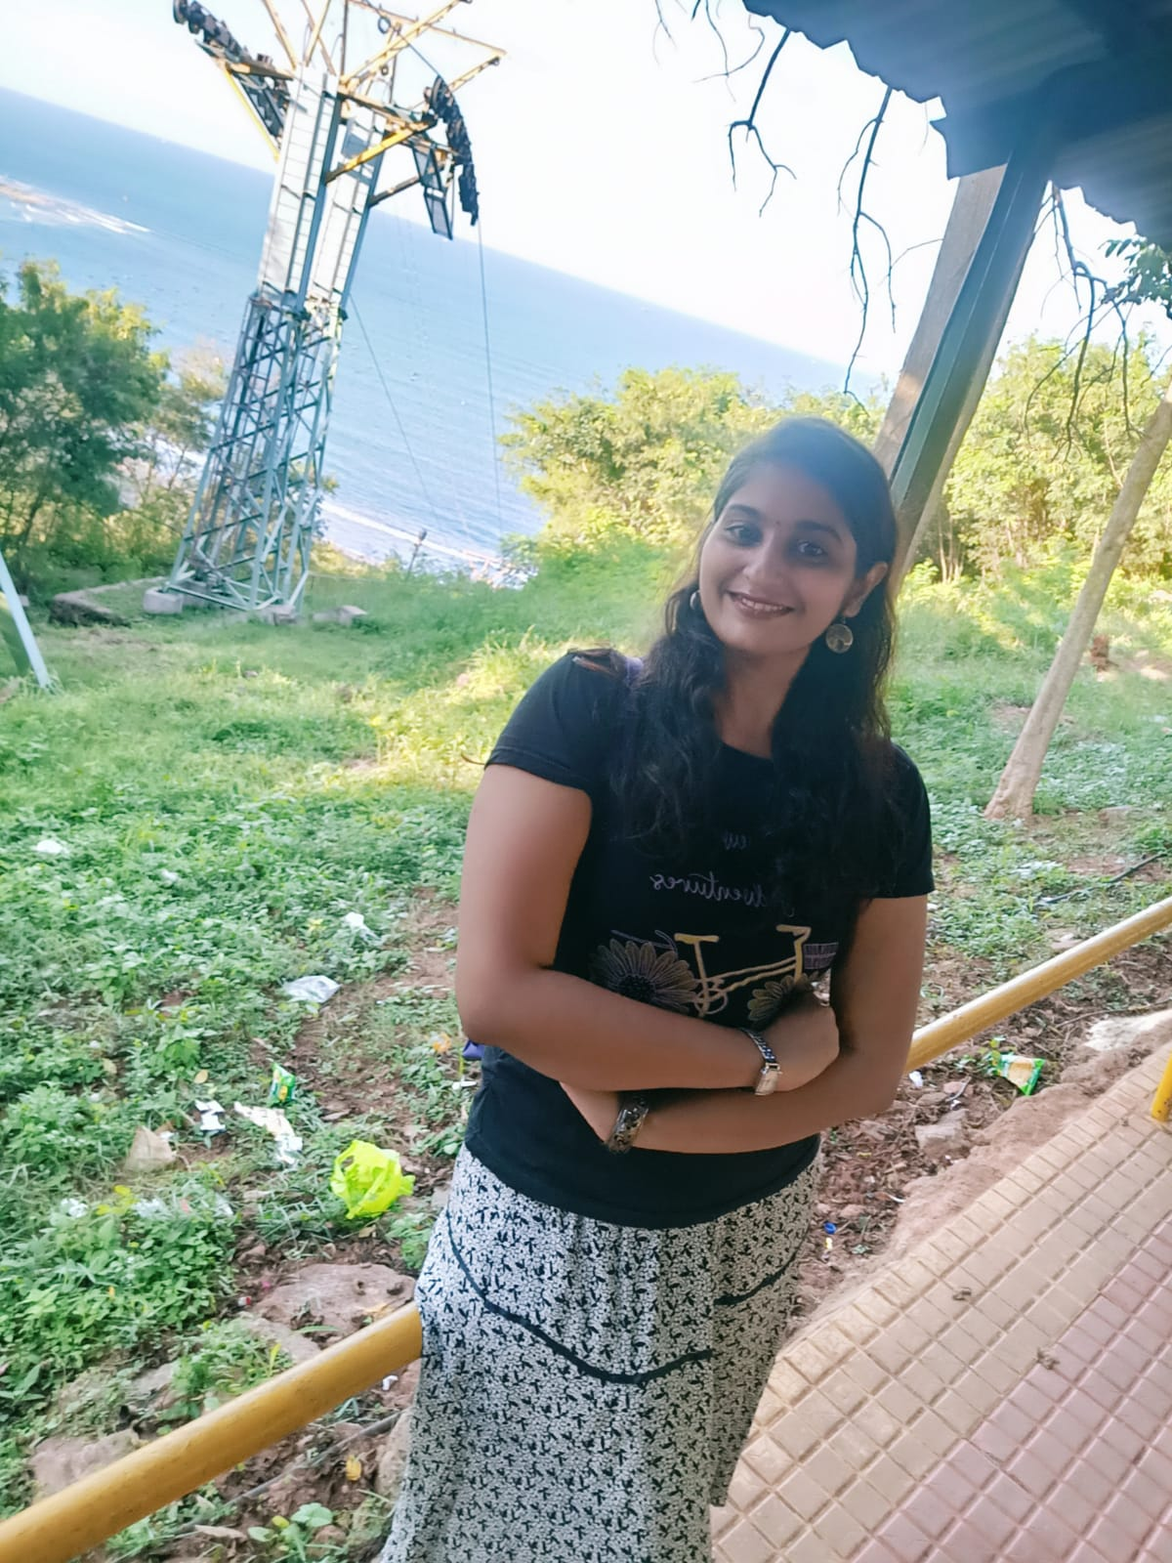
02
Faculty
I am Yashpal!!
And I am going to take all your Math classes!!
I am Rajashekar!
I am going to take your Physics classes!!
I am Akhila!!
And I am going to be your Biology teacher!!

Slide 7
03
Schedule!!
Session-1
Session-2
Tuesdays
Physics
Maths
Wednesdays
Chemistry
Maths
Thursdays
Biology
Maths
Fridays
Physics
Biology
Saturdays
Chemistry
Maths
Sunday
Recoup Day
Recoup Day
Monday
Assignment day

Slide 8
04
Class Timings!
6.45 PM to 7.45 PM
Session 1
Tuesday to Saturday!!
8 PM to 9 PM
Session 2

Slide 9
04
Class Timings!
Sunday Schedule!!
10 AM to 11 AM
Session 1
Physics
12 Noon to 1 PM
Session 2
Biology
2 PM to 3 PM
Session 3
Chemistry
4PM to 6 PM
Session 4
Maths

Slide 10
05
Frequently Asked Questions!
Tell me about how the classes would be run?
Tutoroot, online classes are interactive. Students can interact via Audio, Video & LIVE Chat features on the online classroom platform.
What will you offer for the students?
Tutoroot will provide live Interactive classes, Class recordings, Assignments, Assessments.
Can you tell us about the class timings?
Tutoroot, class timings would be very convenient, and the entire class Schedule will be published in advance.
What do I need to attend the online Classes?
· A Tablet/Laptop/Desktop of Standard Configuration
· Headphone/Microphone
· Active Internet Connection with min. 2mbps in LAN connection OR 4G Internet Connection; 2Mbps Wi-Fi connection
Do you provide any course material?
Tutoroot LEARN platform, provides a very comprehensive course material and mock tests for all subjects, exclusively designed by experts.

Slide 11
05
Frequently Asked Questions!
Do you have qualified teachers running the classes?
You will be guided by experts who have a great track record of successfully coaching students to pass these exams or cleared exams like JEE (Advanced), BITSAT, NEET, AFMC etc. They will help you by providing tips & tricks and the required skills in successfully clearing the exams
What if i need more clarifications? Do I get some extra time to ask more questions?
Every Sunday there are recoup sessions for every subject, which is meant exclusively for clearing doubts and to provide a comprehensive revision of the topics covered in the previous week.
How do i sign up for a free demo class?
You can sign up free demo class at https://www.tutoroot.com
What happens if I miss some sessions due to any reason?
You can always view the recordings of the past sessions any time anywhere and you can also get your doubts clarified every Sunday.

Slide 12
05
Frequently Asked Questions!
How do I pay the course fee?
There are many options available for paying the fees, like Net banking via RazorPay, Online Transactions in the form of UPI Payment, Credit card, and Debit card.
Can I pay the fees by instalments every month?
Yes, please reach out to our representative for more information by sending an email to support@tutoroot.com
What is the duration of the course?
Course duration normally for a period of 2 months, please check the schedule for the start and end date for a specific course!
.

Slide 13
06
Contact Information
For any Clarifications contact !!
support@tutoroot.com

